Slide 1
High-dimensional Histone Modification Data for Predicting Gene Expression using Stacked Temporal Convolutional Networks
Imam Mustafa Kamal¹
imamkamal52@gmail.com
Natanael Yabes Wirawan¹
yabes.wirawan@gmail.com
Nur Ahmad Wahid¹
nurahmadwhd@gmail.com
¹Big Data Department
Business Service Computing (BSC) Laboratory
Pusan National University

Slide 2
Outline
Key points addressed within this presentation
Introduction
Problem
Previous Work
Proposed Method
Experiments
Conclusion & Future Work

Slide 3
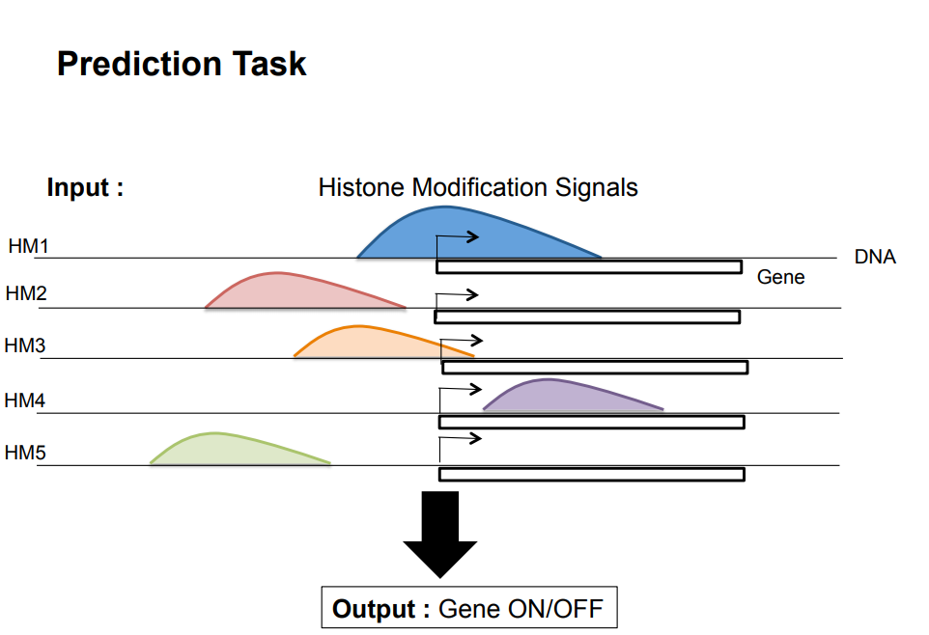

Introduction
Predicting Gene Expression using Histone Modifications Signals
Histone modifications are the most important factors that control gene regulation

Slide 4
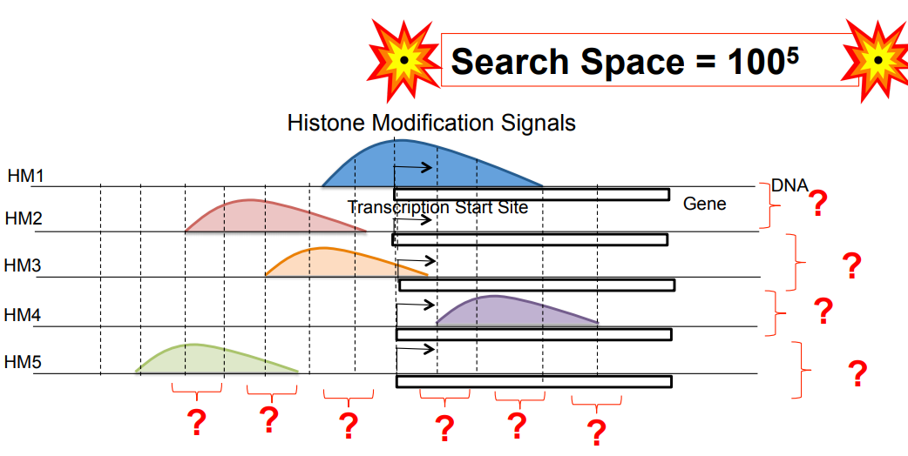
Problem
Predicting Gene Expression using Histone Modifications Signals
Computational methods that predict gene expression from histone modification signals are highly expensive.

Slide 5
Previous Work
DeepChrome: Deep-learning for Predicting Gene Expression from Histone Modifications (Singh, et.al.)
DeepChrome: deep-learning for predicting gene expression from histone modifications
Ritambhara Singh, Jack Lanchantin, Gabriel Robins, Yanjun Qi, 2016
Image 1
Image 2
Deep
Learning
On / Off
Image 3

Slide 6
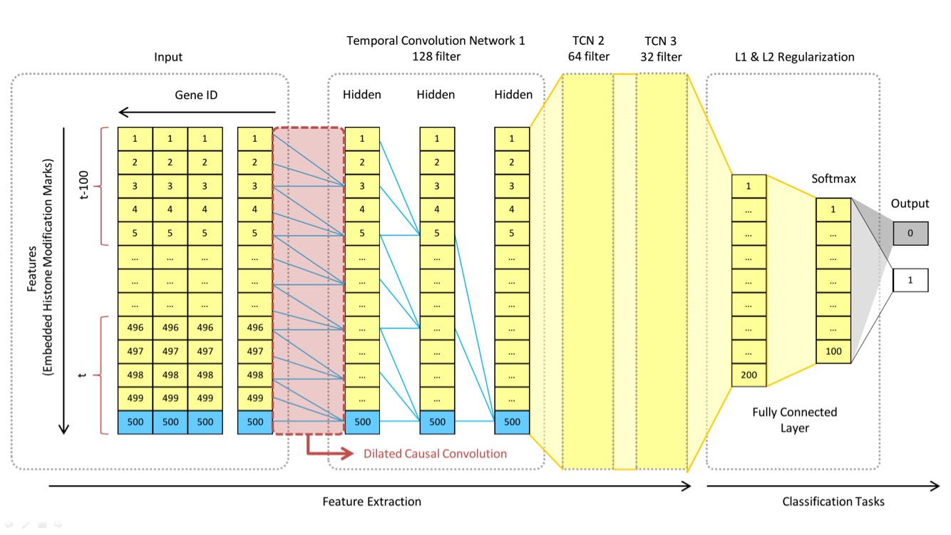
Proposed Method
Converting data to high-dimensional features, therefore each gene_id has 500 features.
Propose Temporal Convolutional Network!
Compare to DeepChrome, TCN considers time-step

Slide 7
Experiment
Dataset and System
Data : Tampere Univ. of Technology which published in Kaggle.
It consists of 15,485 Genes wherein each gene has five HM features with 100 rows.
70% as training and 30% as testing.
System : Tensorflow and Keras with Intel Core i7 4790K CPU, 32 GB RAM, and NVDIA GeForce GTX 1080Ti GPU setup.

Slide 8

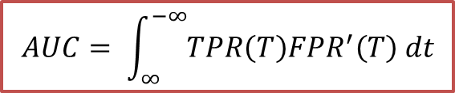


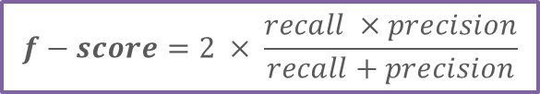

Experiment
Evaluation Metrics
The experiment were carried by evaluating the following metrics:
$$AUC= \int_{∞}^{−∞}{TPR\left(T\right)FPR^{′}\left(T\right) dt}$$
$$recall= \frac{TP}{TP+FN}$$
$$accuracy= \frac{TP+TN}{TP+FN+FP+TN}$$
$$specificity= \frac{TN}{TP+FN}$$
$$precision= \frac{TP}{TP+FP}$$
$$f−score=2 × \frac{recall ×precision}{recall+precision}$$

Slide 9
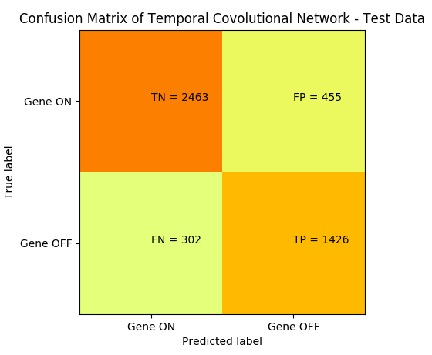
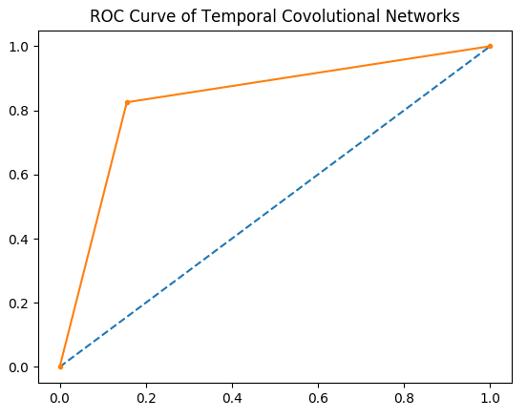
Experiment
Our proposed method performance
Accuracy : 0.837
AUC : 0.835

Slide 10
Experiment
Graph comparison with all methods

Slide 11
Experiment
Detail comparison with all methods
Table. Comparison of TCN with other methods
Method | AUC | Accuracy | Precision | Recall | F-score | Specificity
TCN | 0.835 | 0.837064141 | 0.758107 | 0.825231 | 0.790247 | 0.8440713
DeepChrome | 0.828 | 0.831683168 | 0.752941 | 0.814815 | 0.782657 | 0.8416724
DeepNN | 0.817 | 0.824149806 | 0.750412 | 0.789931 | 0.769665 | 0.8444140
SVM | 0.826 | 0.834266035 | 0.767897 | 0.794560 | 0.781001 | 0.8577793
Logistic Regression | 0.825 | 0.832328885 | 0.763758 | 0.795139 | 0.779132 | 0.8543523
In all criteria, TCN outperforms the state-of-the art method (DeepChrome)
Deep-NN suffers from overfitting
SVM performs best in Precision and Specificity

Slide 12
Conclusion & Future Works
Our proposed method outperforms the state-of-the-art method (DeepChrome).
Our method obtained better results, due to considering the state of each Histone Modification (HM) features for each state by harnessing dilated causal convolution in temporal convolution.
In the future, we would like to use different set of data to measure the robustness of our method.

Slide 13
Thank You
Any Questions?

